Slide 1
Casual Model for Algorithmic Bias Detection and Mitigation in CNN
IDC8208 Project Presentation
Presenter: Byun Min Sik (Roy)
Notes:
Good afternoon professors and classmates, my name is Roy and today I’ll be presenting my work on ‘Casual Model for Algorithmic Bias Detection and Mitigation in CNN Model.

Slide 2
Table of contents
01
02
03
04
Background
Bias Detection
Bias Mitigation
Results and Future Work
Notes:
This are the contents to go through, focusing on the Bias Detection and Mitigation

Slide 3

01
Background
What is Fairness in Artificial Intelligence?

Slide 4

Introduction
Is AI Fair?
Image: https://tinyurl.com/mrctbxup
Notes:
Artificial Intelligence used in many sectors
Benefits
Powerful analysis
humans to make decisions easily
Raise concerns: Is AI Fair?

Slide 5
Main sources of Biases
Training
Algorithm
Data collection
Labelling
Organizational
Algorithm Design
Evaluation
Notes:
Bias may arise from data collection, algorithm design, and evaluation.

Slide 6
3 Main Stages for Mitigation
Pre-processing
In-processing
Post-processing
Notes:
Mitigation approaches happen in 3 main domains.
Adjusting the Dataset
Improving the algorithm design
Altering the output

Slide 7
Related Works
Pre-processing
Joshi and Burlina (2020)
Sharma et al. (2020)
In-Processing
Beutel et al. (2017)
Paul et al. (2022)
Post Processing
Hardt et al. (2016)
Hui, W. and W. K. Lau (2023)
Adjust Data Distribution across demographic groups in Medical Images
Data Augmentation to generate synthetic samples to balance the demography
Applying adversarial training to obscure sensitive attributes during learning
Hybrid methods (data balancing with fairness-aware training) for Generative Model
Adjust output of model to align with Equal Opportunity for Supervised Learning
Casual Model to detect and mitigate bias in Regression Model
Notes:
These are some detection and mitigation approaches.
My approach uses Professor’s Wendy’s casual model approach in CNN Models

Slide 8
Casual Model for CNN?
No Work has been done
Notes:
With that context, let’s discuss how the problem is tackled in this project

Slide 9
Methodology
Data Preparation
Label FairFace Dataset with emotion attributes
Training CNN
Split labelled FairFace Dataset into Train, Val, Test
Bias Detection
Causal Model to detect bias introduced
Using DeepFace pretrained model
Output probabilities of 7 emotion classes
Compare Accuracy of emotion by gender and emotion categories
Bias Mitigation
Calculation of De-biased probabilities
Re-normalization of probabilities
Notes:
This is the overview of the methodology.
We will utilize FairFace Dataset to classify emotions and search for bias introduced by gender.
Then, we will de-bias the output and evaluate the impact

Slide 10
02
Bias Detection
Detection of Bias in CNN with Casual Model

Slide 11

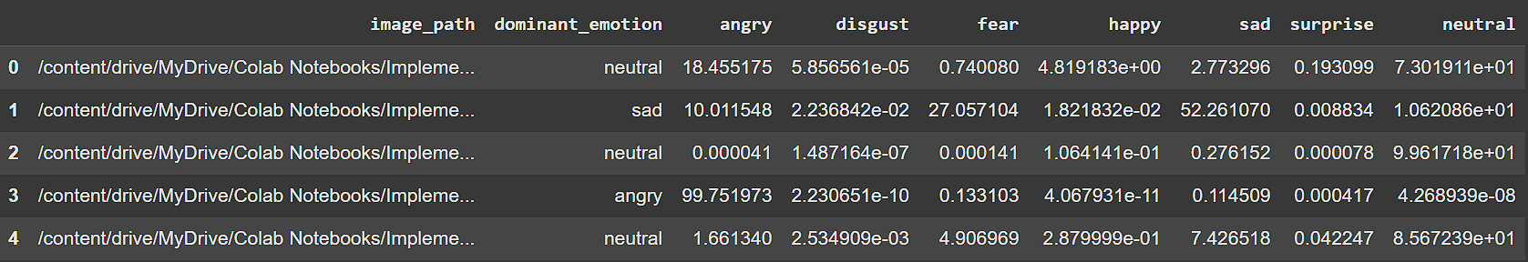
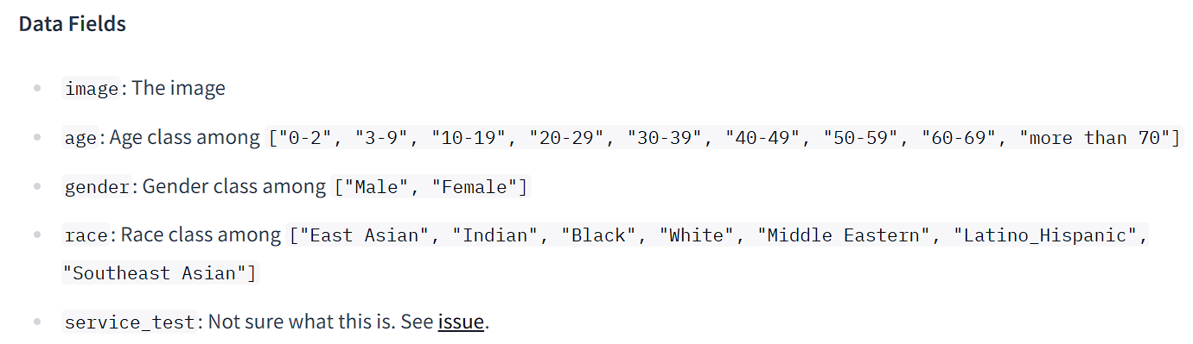
1. Data Preparation
DeepFace
Pre-trained Model
HuggingFaceM4/FairFace
Dataset | No. of Rows
Train | 86.7k
Validation | 11k
Ground Truth
Male: 53%
Female: 47%
Notes:
We utilized FairFace datasets, and labelled them with the DeepFace pre-trained model to establish a ground truth

Slide 12
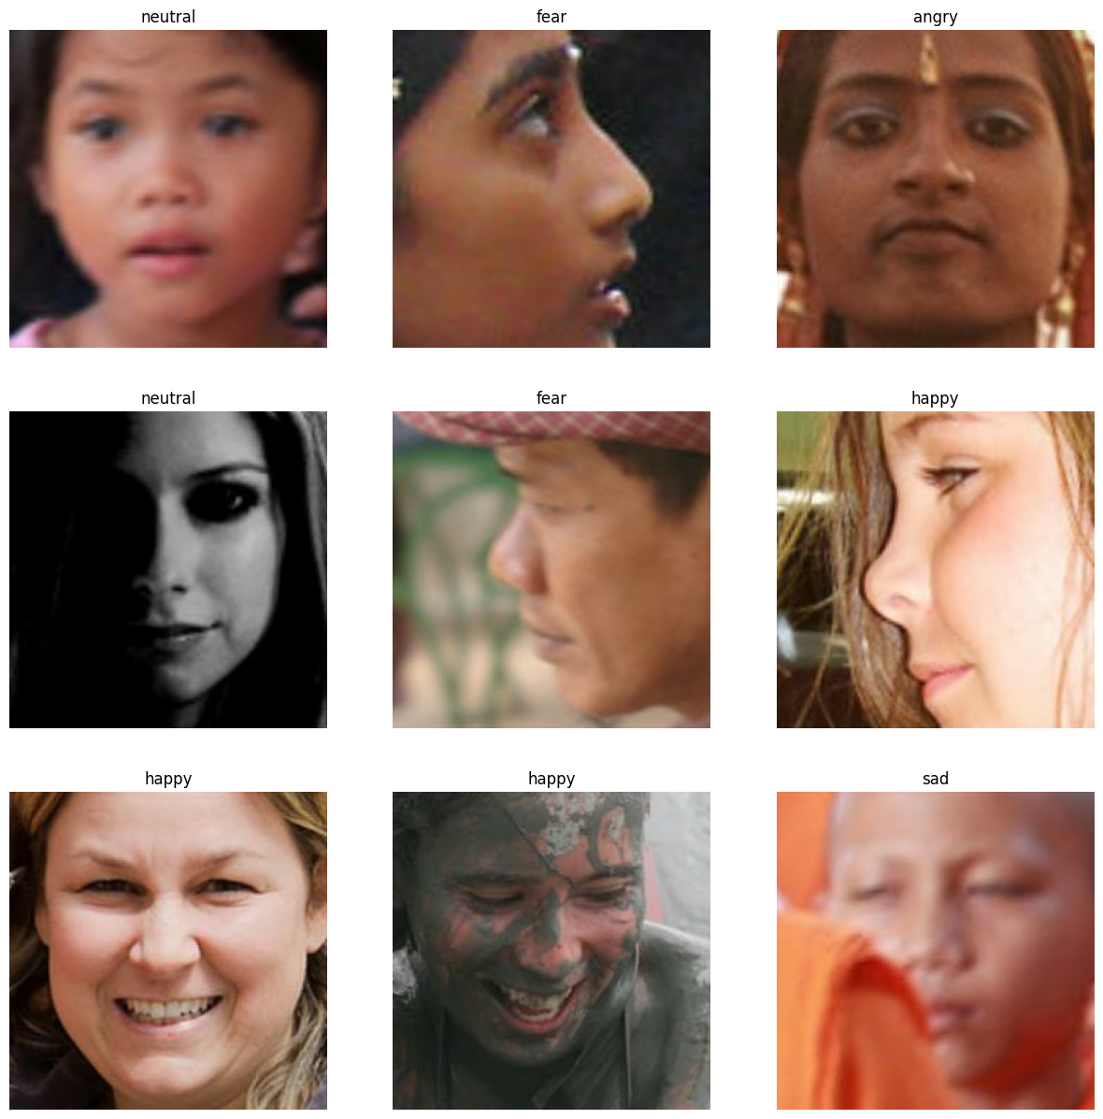
2 Split Dataset
Validation Dataset Split 0.5
Dataset Component | Size (rows) | Description
Training Dataset | 86,744 | Used to train the emotion classifier
Validation Dataset | 5477 | Used for validation
Test Dataset | 5477 | Used to evaluate and predict emotion classification
Combined Dataset | 97,698 | Unified dataset used for emotion labeling
Notes:
The datasets are then split into training, testing and validation set.
Training sets contains 8.6k dataset while the test datasets contains 5k dataset

Slide 13
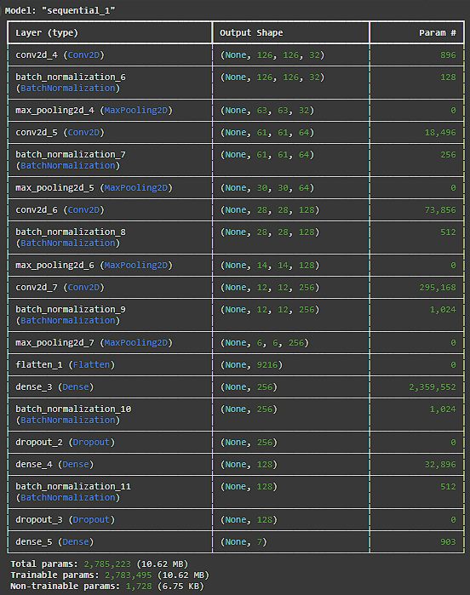
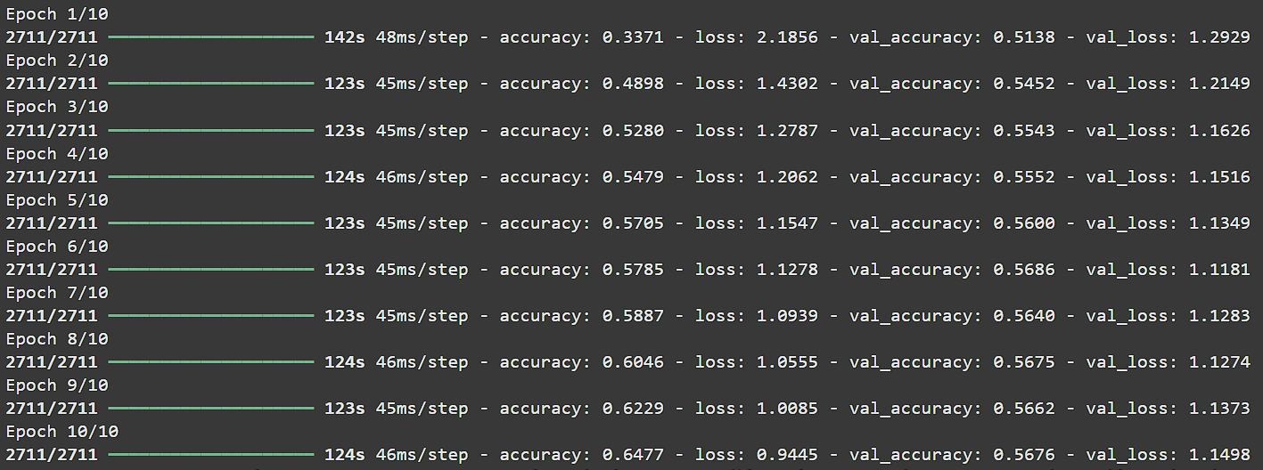
3. Train Custom CNN
Learning Rate: 0.0001
Epochs: 10
Optimizer: Adam
Notes:
The custom CNN model is trained with following parameters
Its validation accuracy ius only 56% but the model accuracy is not the main concern in this work as we are treating CNN as blackbox and our focus is on the output of the CNN model

Slide 14
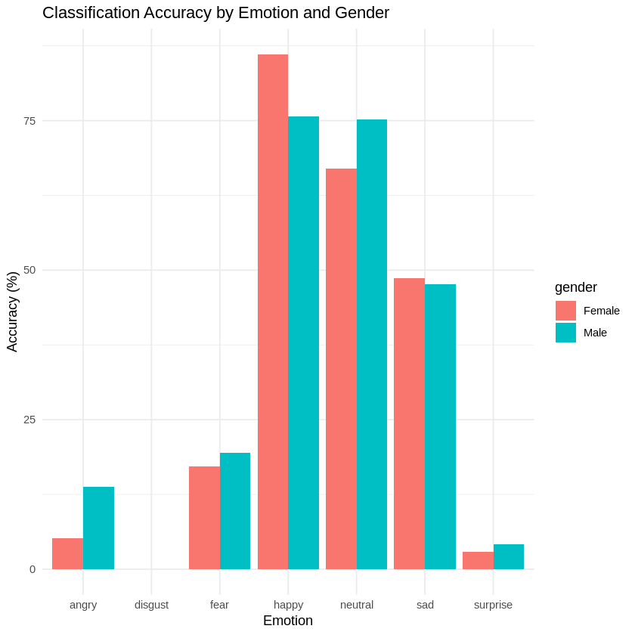
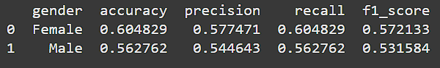
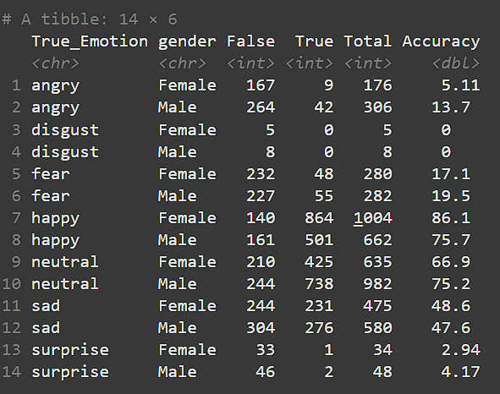
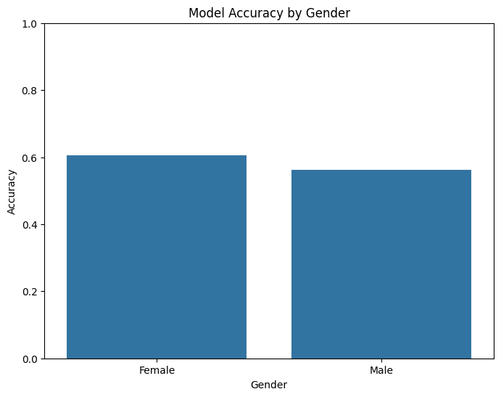
4. Output from Customized CNN
60.48%
56.28%
Notes:
As you can see from the output of CNN, Females have achieved higher accuracy compared to males by 4%.
Also in terms of emotion category, we can see the wide difference of accuracy between genders.
Hence, we would want to find out if gender affects the emotion classifying task by applying the casual model

Slide 15
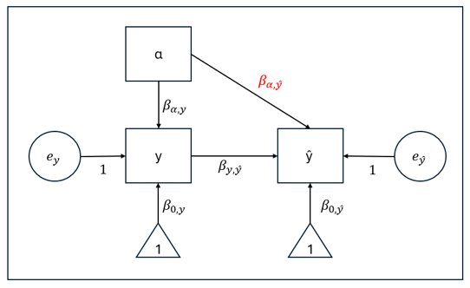
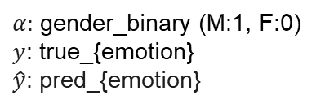
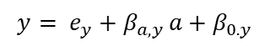
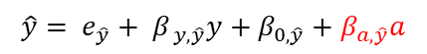
5. Casual Model
$α:$ gender_binary (M:1, F:0)
$y$: true_{emotion}
$\hat{y}$: pred_{emotion}
$$\hat{y}= e_{\hat{y}}+ β_{ y,\hat{y}}y+β_{0,\hat{y}}+β_{a,\hat{y}}a$$
$$y= e_{y}+β_{a,y }a+β_{0.y}$$
Notes:
This diagram shows the casual model for the above scenario.
Alpha represents the Gender in binary form, y is the ground truth, and y-hat is the prediction.
We can formulate 2 equation from here for y and y-hat. In ideal situation where there is no bias,
the influence or weightage from Gender, which is represented as Beta, would be 0

Slide 16
6. Detecting Bias
Significance (p-value) of $β_{a,\hat{y}}$
Emotions | Est. | P-value
Angry | 0.026932053 | 0.000000e+00
Happy | -0.05772604 | -8.945242
Sad | 0.17837000 | 2.643155e-09
Fear | 0.0001316176 | 0.9561599
Disgust | 2.648490e-04 | 1.600250e-03
Neutral | 0.05390080 | 0.000000e+00
P-value < 0.05: Significant → Bias Introduced
Notes:
We would need to find out if bias is introduced. This is done by finding the weightage of Gender using casual model. We can compute the p-value of this weightage to evaluate its significance.
In social science, p < 0.05 is used as threshold to evaluate the significance. That being said, when p-value is less than 5%, there is 95% probabilities that the influence from gender as affected the emotion classification.

Slide 17
03
Bias Mitigation
Mitigation by De-biasing influence of $β_{a,\hat{y}}$
Notes:
After detecting bias, we needed an effective way to mitigate it.

Slide 18

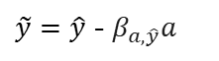
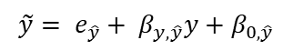

1. Removing $β_{a,\hat{y}}$to find $\tilde{y}$
Ideal de-biased predicted probability
$$\tilde{y}= e_{\hat{y}}+ β_{y,\hat{y}}y+β_{0,\hat{y}}$$
Current equation
$$\hat{y}= e_{\hat{y}}+ β_{y,\hat{y}}y+β_{0,\hat{y}}+β_{a,\hat{y}}a$$
Remove the influence from Gender attribute
$\tilde{y}=\hat{y}$ - $β_{a,\hat{y}}a$
Notes:
We developed a debiasing equation to neutralize the influence of gender on the predicted probabilities

Slide 19
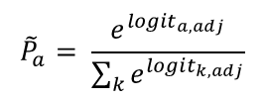
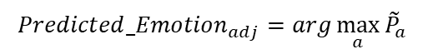
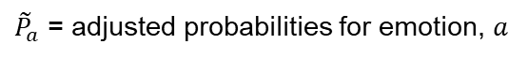
2. Re-normalization using SoftMax
Apply the SoftMax function to the adjusted logits to obtain adjusted probabilities that sum to 1:
${\tilde{P}}_{a}$ = adjusted probabilities for emotion, $a$
$${\tilde{P}}_{a}= \frac{e^{{logit}_{a, adj}}}{\sum_{k}{e^{{logit}_{k,adj}}}}$$
For each data point, determine the emotion with the highest adjusted probability:
$${Predicted_Emotion}_{adj}=arg\max_{a}{{\tilde{P}}_{a}}$$
Notes:
SoftMax ensured the adjusted probabilities remained valid, summing to 1
Then the emotion with highest probability would be selected to be the dominant emotion

Slide 20
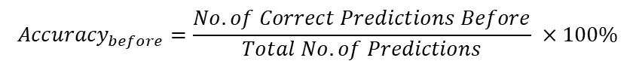
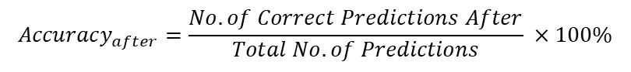
3. Evaluation of Mitigation
$${Accuracy}_{before}=\frac{No. of Correct Predictions Before}{Total No. of Predictions} ×100\%$$
$${Accuracy}_{after}=\frac{No. of Correct Predictions After}{Total No. of Predictions} ×100\%$$
Notes:
Then we can compare the accuracy before and after the bias mitigation

Slide 21
04
Results

Slide 22
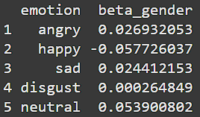
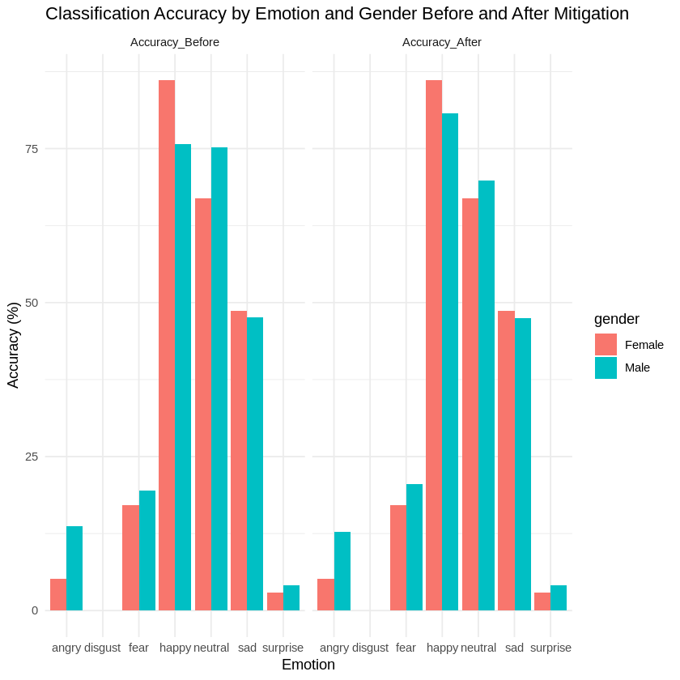
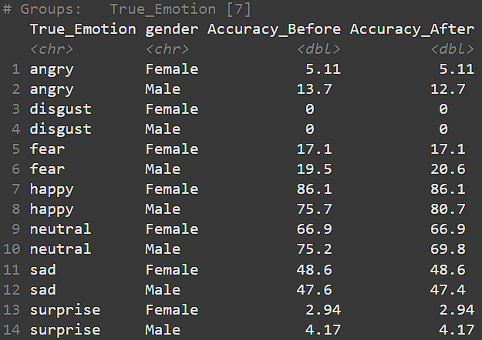

Slide 23
Emotion | Gender | Acc_Before (%) | Acc_After (%) | Gap Before | Gap After | Gap Difference
Angry | Female | 5.11 | 5.11 | -8.59 | -7.59 | Decrease
 | Male | 13.7 | 12.7
Disgust | Female | 0 | 0 | 0 | 0 | -
 | Male | 0 | 0
Fear | Female | 17.1 | 17.1 | -2.4 | -3.5 | Increase
 | Male | 19.5 | 20.6
Happy | Female | 86.1 | 86.1 | 10.4 | 5.4 | Decrease
 | Male | 75.7 | 80.7
Neutral | Female | 66.9 | 66.9 | -8.3 | -6.7 | Decrease
 | Male | 75.2 | 69.8
Sad | Female | 48.6 | 48.6 | 1 | 1.2 | Increase
 | Male | 47.6 | 47.4
Surprise | Female | 2.94 | 2.94 | -1.23 | -1.23 | -
 | Male | 4.17 | 4.17
Notes:
As you compare the accuracy before and after mitigation technique, we can observe that the gap between genders have decreased for emotions where the bias was significant.

Slide 24
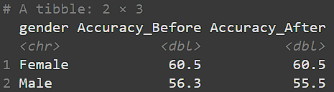
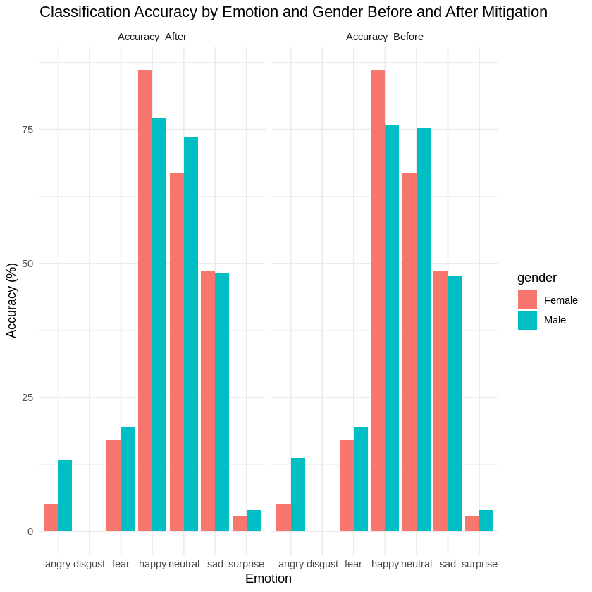
Conclusion
Overall Accuracy has drop after mitigation
Generally, the difference of accuracy by gender has decreased
More fairer classification
Notes:
In conclusion, this are the finding from my topic.
The overall accuracy dropped slightly after bias mitigation, but fairness—measured by reduced gender-based accuracy differences—improved significantly.

Slide 25
Future Work
Improving Models used
Repeating the work with better emotion labelling model & Customized CNN
Attributes Removal from Picture
Remove Colour
Extract facial information only
Train with these attributes to predict emotion of real person
Notes:
Last but not least, I believe that there can be more improvement to be made.
We can increase the accuracy of the Models to solidify the ground truth and reliability.
Also, we can experiment with training CNN with debiased images by extracting only outlines of facial attributes to observe fairness between gender.

Slide 26



